Slide 1
TCU Visibility Project Proposal
Branding and PR Success
Presented by Trish Helgeson and
Annette Schilling Willis, Agency MABU
Presented by American Indian College Fund & Thunderbird Strategic
Presented by Thunderbird Strategic, LLC

Slide 2
Branding 101

Slide 3
What is a Brand?
Your
brand is
MORE than
your logo

Slide 4
What is a brand?
Your brand is an intangible feeling of many elements working together to tell your story and create a perception about your organization.
name
logos
messages
images
colors
textures
typestyles
symbols
sounds
advertising
experiences
reputation
reviews
word or mouth

Slide 5
Building a Brand Identity

Slide 6
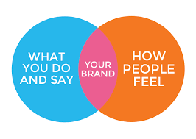
Building a Brand Identity
Brand Identity: Much like individuals, organizations have their own personality and unique characteristics.
These “personas” are created and shaped by perceptions, assumptions, hearsay, and actual experiences.
“Your brand is what other people say about you (in social media) or when you’re not in the room.” (Jeff Bezos, Amazon)

Slide 7
Creating your Brand Story
Reflects your brand personality
Who you are and what you offer
Consistent the mission and vision of your organization
Amplifies your unique value proposition (differentiation)
Why your audience cares
What makes your brand different
What problem does your brand solves
Connects with your audience on an emotional level
How does your product transform your audiences’ life
How does your product make them feel
How are you building relationships, providing a sense of belonging and creating loyalty

Slide 8
Consistency is Critical
Strong brands are consistent across all platforms
Every element works together to create consistent experiences
Consistency creates synergy and increases confidence
Branding is a long-term effort of discipline
Results - increased awareness, value, trust and loyalty

Slide 9
Steps to Building Your Brand
Determine your audience
Define your mission
Research your competitors
Determine what differentiates your brand
Develop your brand identity and persona
Create your brand story and messaging
Create your visual brand identity
Integrate your brand elements across all aspects of your business
Be consistent
Engage with audience to create brand ambassadors

Slide 10
Case Study:
Nueta Hidatsa Sahnish College (NHSC)

Slide 11
Case Study – NHSC
Logo
Positioning
Consistent execution

Slide 12
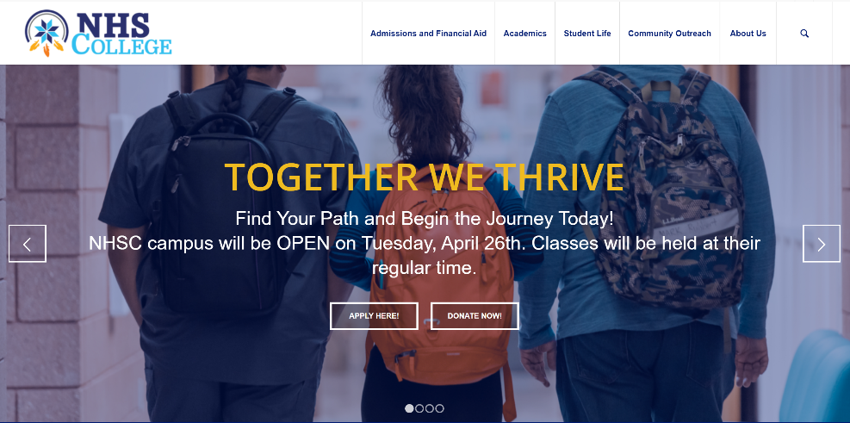
Case Study – NHSC
Logo and brand standards executed consistently across all platforms and materials.
Together We Thrive creates a sense of community, aspiration, nods to the family nature of staff and the team approach in preparing students for the future. It describes both the college experience and the student’s future.
The positioning is an umbrella message that supports the mission and vision of the organization. Thrive can used in many ways and woven throughout message strategy.

Slide 13
Getting the Word Out:
NHSC’s Success Story

Slide 14
NHSC PR Program Growth

Slide 15
NHSC Top Stories: * Student assistance * New programs * Student awards/achievements * Faculty awards/successes * Policy/legislative action * Expansion

Slide 16
Steps to Building Your PR program
BUILD
Develop a press release template
Create a media data base
Engage your team members to share story ideas
Build relationships with media
LAUNCH
Determine what is newsworthy
Personalize with quotes and images
Determine the audience for each story
Get it out while its still newsworthy

Slide 17
Thank you.

