Slide 1
TCU Visibility Project Proposal
Expand Your Online Presence
Digital Marketing Strategies for Tribal Colleges
Agency MABU Steph Landwehr, Director of Media Services
Presented by Thunderbird Strategic, LLC

Slide 2
Social Media Platforms

Slide 3
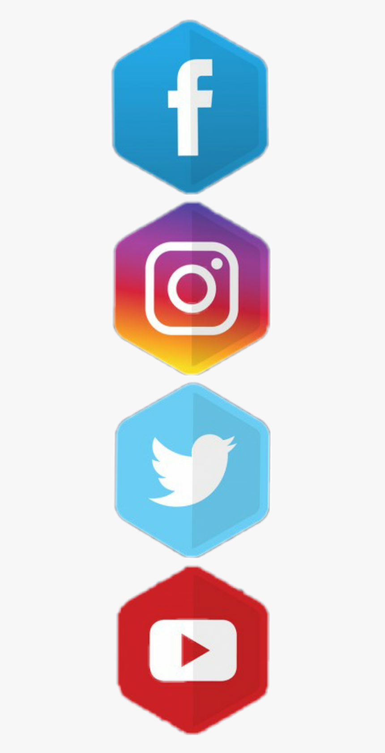
Facebook
Over 2.7 billion daily active users
Algorithm – ranking system
Businesses should pay to play
Instagram
Largest age group: 25-34
2nd largest network after Facebook
Use video, high-quality images, and influencers
Twitter
320 million daily users
Ask a question, use polls, photos, videos, gifs
Great for news, customer service, sports scores
YouTube
Over 2 billion monthly users
Go-to video network for internet at large
Advertising is cost-efficient and a great way to reach a large audience
Notes:
1. Facebook – has over 2.7 billion monthly active users. Despite ever-emerging competition, Facebook remains the most-used and engaged-with social platform across all age groups.
It uses an algorithm which is a ranking system
It ranks all posts that can display on a user’s newsfeed based on how likely that user will have a positive reaction and engage with that content.
It prioritizes content that’s meaningful and relevant
FB business page visibility has gone down so because of that
They really want businesses and organizations to Pay to Play.
Consider putting money behind your best-performing organic content to sponsor/boost those posts
2. Instagram – Is a very popular, visual platform and it’s where young adults go to get inspired. 63% of its 1 billion monthly active users are between the ages of 25-34. We’re seeing younger generation move away from Facebook to Instagram. Instagram is known for reels which are short form videos. It’s also the best and most preferred platform for influencer marketing.
3. Twitter – News heavy platform with 320 million monthly active users. Twitter also makes it possible for users to reach nearly any person or organization simply by tagging them in a tweet. It’s a popular platform for customer service, allowing users to air complaints and customer service teams can react quickly. It’s also great for keeping track of the latest sports scores.
It’s very “real-time” and tweets last only seconds in a person’s feed. With Twitter you can easily pose questions, use polls, photos, videos, gifs and hashtags.
4. YouTube – YouTube an extremely popular video platform with over 2 billion monthly users.
It remains the go-to video network for the internet at large.
It’s popularity among younger users highlights the ongoing, long-term shift toward video content.
It’s also a great platform for advertising. It’s extremely cost effective and a great way to reach a large audience.

Slide 4
Pinterest
Over 400 monthly active users, largest age group 30-49
78% women, 22% men
The most product-focused of any social network
Ideal for ecommerce merchants selling home, style, and fashion goods.
LinkedIn
774 million users
Build strategic relationships
Great for job postings
TikTok
1 billion monthly active users, largest age group 18-24
Don’t make ads, make TikToks
Emerging ad features as the network grows – ideal for national brands
User-generated content (aka word of mouth marketing)
Notes:
1. Pinterest
Over 400 monthly active users, largest group are women ages 30-49
The most product-focused of any social network.
Most ideal for ecommerce merchants selling home, style, and fashion goods.
2. LinkedIn – A professional networking site and is the top social media platform for B2B social media marketing.
Great for building strategic relationships, thought leadership, and promoting the organizational side of your brand.
Great for job postings
3. Finally, the last social platform we’ll touch on today is TikTok – which is taking social media by storm.
1 billion monthly active users, largest age group are those 18-24
At its core, TikTok is a video sharing app and it encourages business to not make ads, and, instead, make TikTok videos.
Emerging ad features as the network grows – right now, it’s ideal for national brands but they’re continuing to rapidly build their targeting features.
User-generated content or word of mouth marketing thrives here. Users share their brand experiences with the public and aren’t paid.

Slide 5
Social Media Content Strategy

Slide 6
Who is Your Target Audience?
Think about your audience
Who are you trying to reach?
Where are they spending their time?
Search “2022 Social Media Demographics”
Build a connection with your audience
Social media content should not feel like marketing
What would your audience find value in, care about, and ultimately, engage with?
Be responsive
Notes:
Before you start creating an account on every platform, think about your audience – who are they? Who are you trying to reach? Where are they spending their time?
This is very important when it comes to your social media content strategy. While there are many social media channels to consider having a presence on, it’s more important that whichever channels you choose, you do them well. Develop a consistent posting schedule so your page doesn’t become stagnant. You want to stay active, so your audience stays engaged.
There are many resources out there if you search “2022 Social Media Demographics” to help you determine the best platforms for you.
The overarching goal of social media content is to post info that builds a connection with your audience.
Social media content should not feel like marketing.
Think about what your audience would find value in, care about and ultimately share.
Be responsive.
Social media is a two-way street. Think of it as a conversation.
Respond to comments and questions on posts.

Slide 7
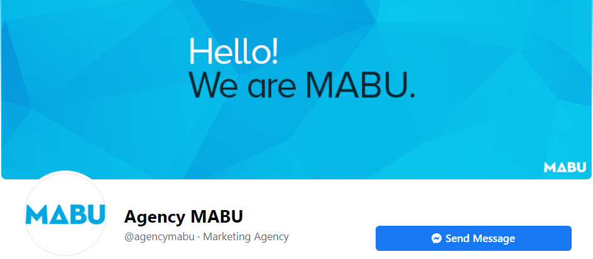
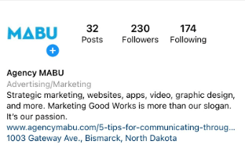
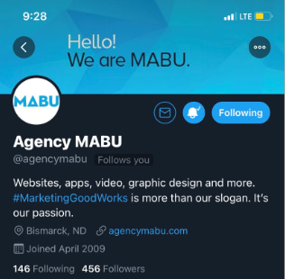
Social Media Priorities
Develop a social media strategy, plan, and content calendar that’s doable for you.
Free scheduling tools (i.e., Hootsuite, Buffer)
Set up your social profiles to reflect your brand identity.
Develop a program to monitor and measure social media metrics.
Notes:
Social Media Priorities when getting started
Develop a social media strategy, plan, content calendar that’s doable for you.
Use free scheduling tools like Hootsuite, Buffer
Set up your social profiles to reflect your brand identity
Ensure your logo and cover image and bio or about content is consistent on all social channels.
Develop a program to monitor, measure and report social media metrics.
Utilize the “Insights” or “Analytics” sections of your social media channels to analyze and benchmark performance.
Learn from and better optimize.

Slide 8
Digital Advertising

Slide 9
Why Choose Digital Advertising?
Measurable
Real-time data
Control
Cost-effective
Notes:
Why Choose Digital Advertising?
Digital advertising is a way to deliver promotional content to users through various online and digital channels. It leverages mediums such as social media, email, search engines, mobile apps, and websites to show advertisements and messages to audiences.
Unlike more traditional forms of advertising such as print, TV and radio, it’s measurable through real time data
You also have more control of the data – can make adjustments/updates to your campaigns anytime
Cost-effective – can work with virtually any budget

Slide 10
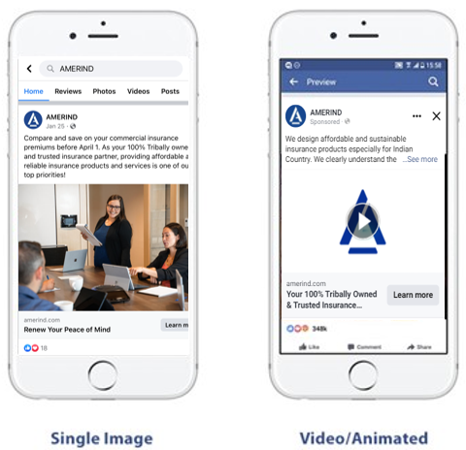
Paid Social Media Ads
One of the quickest and most effective ways to connect with your target audience
Relatively low cost
Abundant targeting capabilities
Video ads outperform static image ads
Notes:
Social Media Ads – Great starting point
It’s one of the quickest and most effective ways to connect with your target audience.
You can tap into all the data users share on social media to offer highly personalized and relevant content to them. Great way to build brand awareness.
Whichever platform you choose, you can also consider advertising on it.
Low cost – you pick your budget
There are abundant targeting capabilities

Slide 11
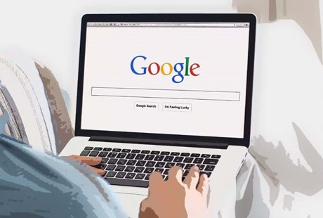
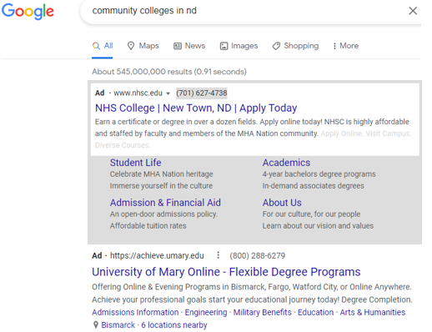
Search Engine/Keyword Marketing
Ads appear on search engine results pages
Bid on keywords
Pay-per-click (PPC)
Notes:
Another form of digital advertising is Search Engine Marketing or Keyword Marketing
When searching for something on Google, a few search results with the tag “ad” appear at the top of the Search Engine Results Page. These ads are a result of keyword marketing.
Keyword marketing is arguably the most used ad format. How it works is you bid on keywords along with your competitors to appear at the top of the search results page.
These ads are usually Pay Per Click (PPC), paying only when someone clicks on your ad.

Slide 12
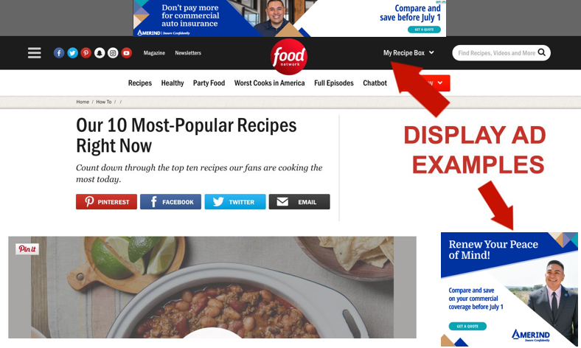
Display Ads
Text and image ads
Appear on websites and publisher pages
Image, mobile, text, banners, pop-ups, video ads
Notes:
Display Ads
Primarily use text and images and appear on websites and publisher pages that are affiliated with search engines
The most common types of display ads are images, mobile, text, banners, pop-ups, and video ads.

Slide 13
How to Implement Digital Advertising
Must have website to send traffic to
Self-serve platforms
Social: Facebook, Instagram, Twitter, etc.
Google Ads: Search, display, YouTube
Programmatic AdTech
Tools and software that enable the programmatic buying and selling of ads
Can accomplish this by working with companies, vendors or agencies
Notes:
How to Implement Digital Advertising
First and foremost – must have a website to send people to when they click on your ad
Self-serve platforms make it easy to get started
Social: Facebook, Instagram, Twitter, etc.
Google Ads: Search, Display, YouTube
Programmatic AdTech
Consists of tools and software that enable the programmatic buying and selling of ads.
Programmatic is the automated system by which millions of ads can be served to millions of internet users across millions of websites – in real time – and clicks and responses can be tracked, measured and reported to the advertiser
There’s a huge ecosystem of companies, vendors, and agencies out there to help you accomplish this.

Slide 14
Digital Advertising Best Practices
Have a strong call-to-action
“Buy Now,” “Learn More,” “Register Today”
Keep it simple
Less is more
Avoid long, text-heavy ads
Be device and channel responsive
Ad creatives should render well on any device or screen size while being relevant to the platform itself
Follow brand guidelines
Place your brand identity design strategically on your ads
Test, test, test
A/B test
Experiment to see what works best and focus on doing more of that
Notes:
Lastly, I want to leave you with some Digital Advertising Best Practices
Have a strong call-to-action
CTAs act as a gentle nudge for your audience
Prompts your user to take the next step and click-through to your website
Keep it simple
Your audience doesn’t have all the time in the world to read through a long text heavy ad. The simpler the ad, the more effective it will be
Be device and channel responsive
Ensure your ad creatives appear correctly and are optimized for mobile, laptop, desktop and tablet. Follow the recommended ad specs for each platform.
Follow brand guidelines
Your brand identity differentiates you from the rest of the pack. Make sure you stand out by placing your brand identity on your ads – logo, brand colors, etc.
Test
A/B testing is widely used among marketers and advertisers to understand what resonates with their audience.
Experiment with different ads and messaging to see what works best for you.

Slide 15
Content Tips
Be authentic
Create bite-sized, snackable content
Produce and share videos
Match the context of the platform you’re on – be seamless and consistent
Be friendly, personable, and compassionate
Opt for humor if/when appropriate
Answer the questions your audience asks
Maintain good quality and consistency in branded graphics, photos, infographics
Link your blog or newsletter content on social, direct to website
Interact with your audience, respond to comments
Share testimonials/success stories
Go “live” from activities and events
Use emojis when appropriate🙌🏼
Celebrate your staff and students
GIVEAWAYS
Be the biggest fans of your community

Slide 16
Free Design & Creative Resources
Design Templates
Canva – www.canva.com (apply for nonprofit for Canva Pro)
Fotor - https://www.fotor.com/ngo.html (apply for premium accounts)
StockLayouts - https://www.stocklayouts.com/Templates/Free-Templates/Free-Sample-Templates.aspx
Stock Photos
CDC Public Health Image Library - https://phil.cdc.gov/Default.aspx
ND Photo Asset Bank – https://www.medialibrary.nd.gov/assetbank-nd/action/viewHome
Pexels – www.pexels.com
Pixabay – https://pixabay.com
Unsplash -
Wikimedia Commons – https://commons.wikimedia.org/wiki/Main_Page
Stock Video
Pexels – https://www.pexels.com/videos/
Videezy – www.videezy.com
Videvo – www.videvo.net
Free Music
Incompetech – https://incompetech.com/music/royalty-free/music.html
Dig CC Mixter – http://dig.ccmixter.org/free
Free PD – https://freepd.com
Free Video Editing Software
DaVinci Resolve - https://www.blackmagicdesign.com/products/davinciresolve
Hitfilm Express - https://fxhome.com/product/hitfilm-express
Apple iMovie - https://www.apple.com/imovie/

Slide 17
Q & A Discussion
Sources: https://blog.hubspot.com/marketing/state-of-social-media-demographics
https://sproutsocial.com/insights/new-social-media-demographics/
https://offers.hubspot.com/social-media-trends-report-2022

